Slide 1
UKIEPC 2019
Summary and solution outlines

Slide 2
Problem Solutions

Slide 3
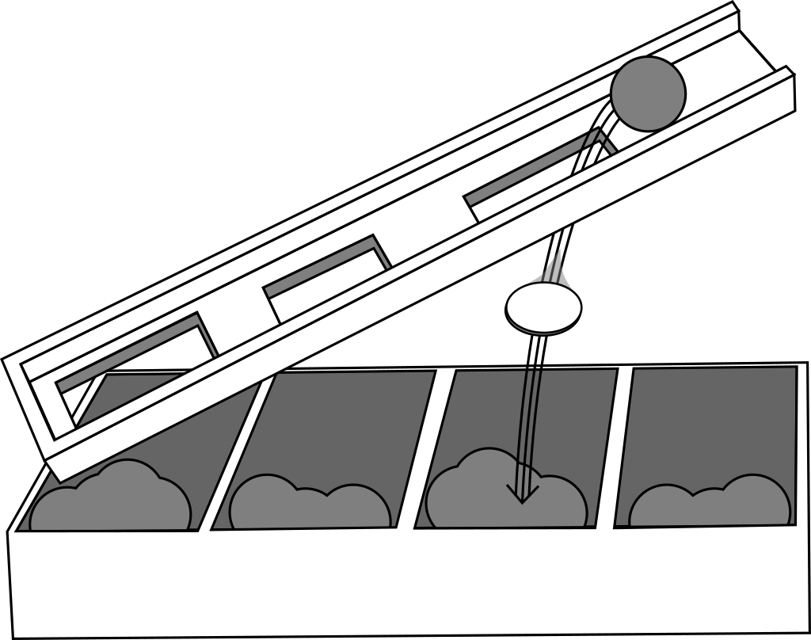
Auto Accountant
Overview
We represent a coin with coords (X,Y) pair. A coin falls into a slot (U,V) if X≤U and Y≥V.
For each coin, find the first slot in the list that matches and add its index to the answer.
24 correct • solved at: 01:02 by
AmaTRINciana
University of Cambridge
Author: Robin Lee

Slide 4
Automatic Accountant - Solution
Techniques
Algorithm
Segment trees
KD trees
Keep a segment tree mapping for one axis:
For all slots with thickness >= T,
Which one has the lowest index? (min-segment-tree)
Initially this tree is empty
Sort the coins and slots along the other axis
Iterate through both in parallel, inserting slots as their trigger masses become eligible for the current coin.
Use the tree to find the slot with the smallest index, out of those with the right mass range.
Alternatively, use a KD / quad tree

Slide 5
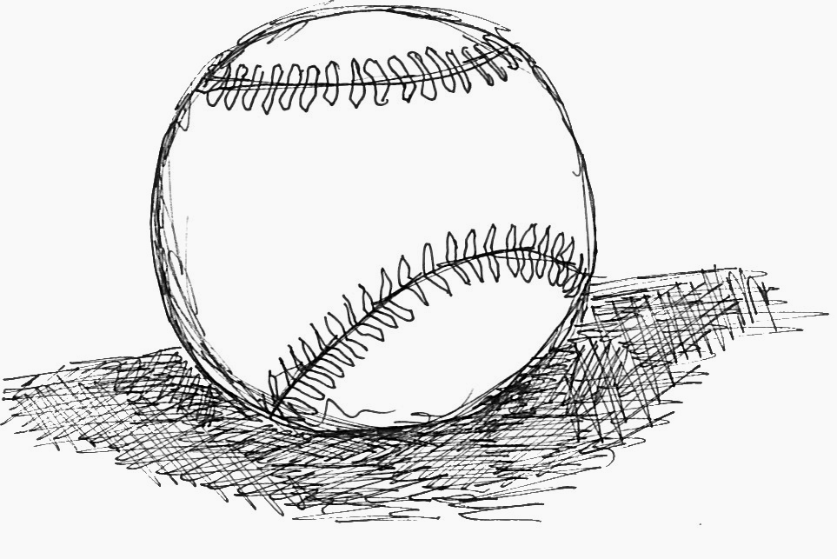
Ballpark
Overview
Estimate a number to one significant figure (exactly one nonzero digit).
The number fits inside a 64-bit integer
(c++: int64_t)
(java: long)
(python: number)
174 correct • solved at: 00:03 by
Ananas
University of Cambridge
Author: Jim Grimmett

Slide 6
Ballpark Estimate - Solution
Techniques
Algorithm
Logarithms
Rounding
If we reduce the number to {x}.{abcdefg} where x is a single-digit number, we can just round it and add zeroes back on later. We just need to make sure to keep the extra information after the decimal point.
while (number >= 10) { tens++, number /= 10.0; }
number = int(round(number))
while (tens > 0) {tens--, number *= 10; }
Or (since only the first two digits matter):
int(round(int(s[0:2]) / 10.0)) * (10**(len(s)-3))

Slide 7
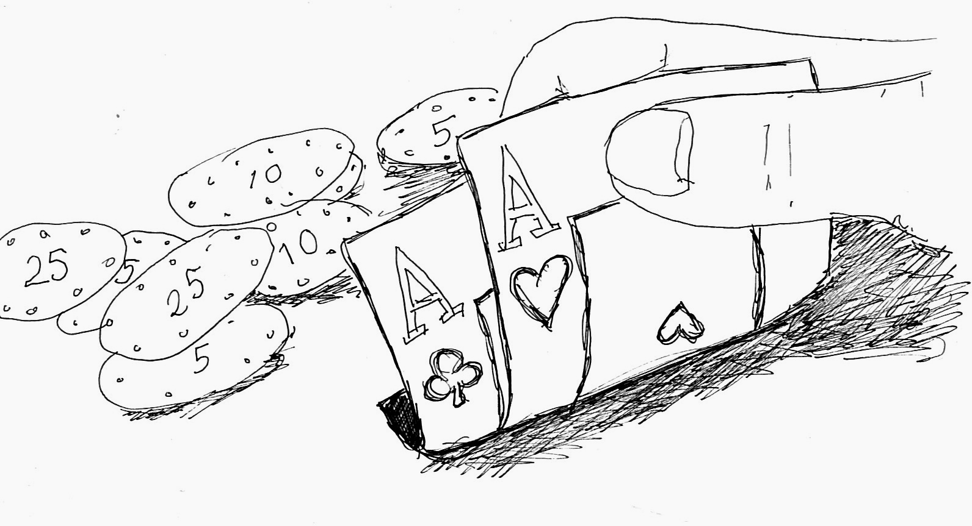
Crooked Dealing
Overview
Partition some numbers into as many groups of K as possible,
But make sure the name number never shows up in the same partition twice.
81 correct • solved at: 00:20 by
Treeniceratops
University of Cambridge
Author: Robin Lee

Slide 8
Crooked Dealing- Solution
Techniques
Algorithm
Greedy algorithms
Priority queues
Use a hashmap (or Python’s Counter class) to get the frequency of all the cards. It’s always best to try and get rid of the most frequent card as fast as possible.
Put the cards into a priority queue ordered by frequency.
While the queue has enough elements to make a hand:
Pop the largest K items from the queue
Add the values to the answer
Reduce the frequencies by one
Reinsert the items and new frequencies into the queue
They may not have the same ordering in the queue afterwards.
Or, binary search on the answer X, lay the numbers out into a grid with X columns, and the answer is the columns of the grid.

Slide 9
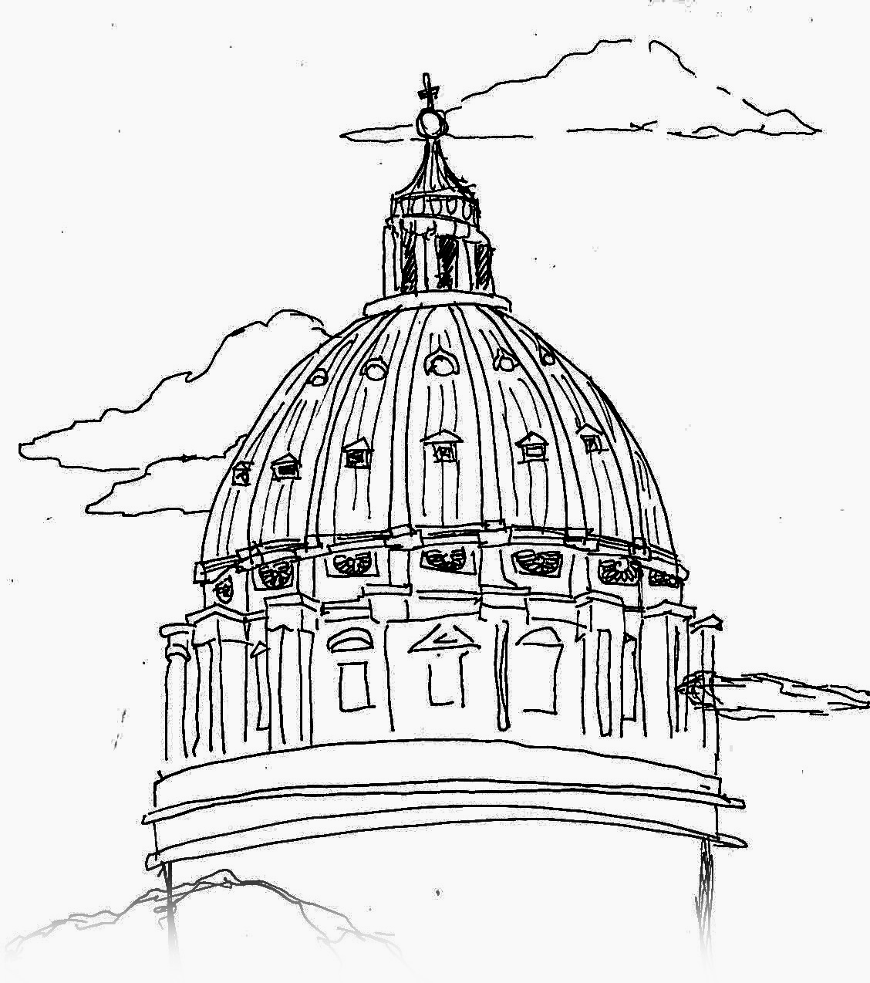
Dome
Overview
There are some points in 3D space
We have a dome sited at the origin
How big do we have to make the dome to capture K or more of the points?
122 correct • solved at: 00:11 by
BigBoggerBoys2:ElectricBoogaloo
Dublin City University
Author: Jim Grimmett

Slide 10
Dome Construction- Solution
Techniques
Algorithm
Sorting
Geometry
The actual positions of the points don’t matter, just how far they are from the origin. Map the points to hypot(x,y,z) or hypot(hypot(x,y),z) if your programming language doesn’t take 3 arguments.
Now sort them. This will put the closest K distances as the first K elements of the array!
So now you can just print the Kth element.
Or: binary search on the answer (a very versatile algorithm) and count how many points match to decide to go lower/higher.

Slide 11
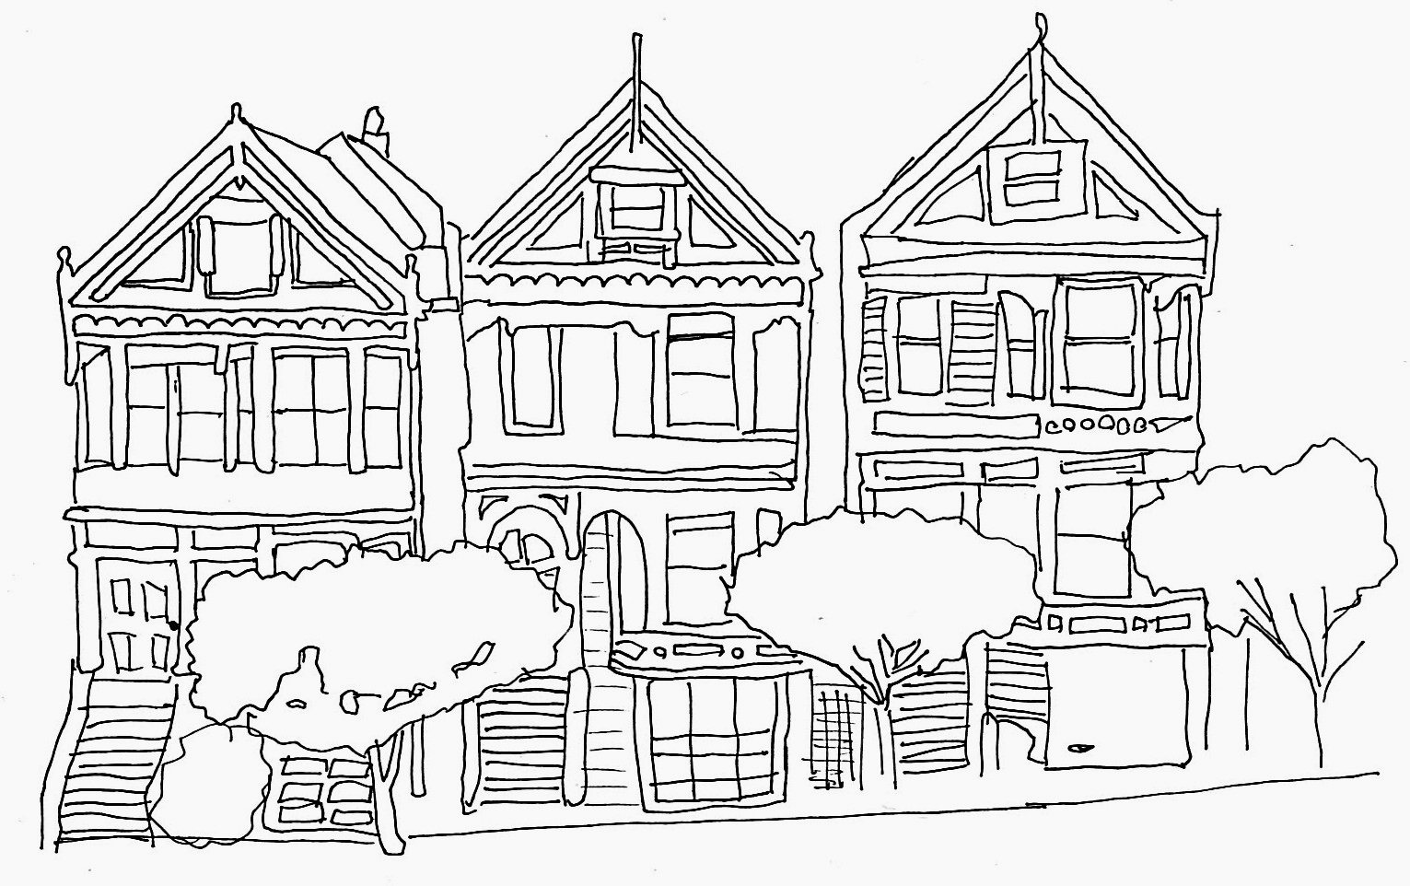
Estate Agent
Overview
Some people want to buy each others’ houses. We want to earn money.
What’s the largest possible sum of transactions we can make?
6 correct • solved at: 01:15 by
Treeniceratops
University of Cambridge
Author:
Bjarki Ágúst Guðmundsson

Slide 12
Estate Agent - Solution
Techniques
Algorithm
Bipartite graphs
Hungarian algorithm
Make a graph where people are vertices, and so are houses. Make an edge between a person and a house if they want to buy it and assign the offer value as the weight.
Crucially, also make an edge between a person and their own house with a zero weight. This is the default case.
Now we have another bipartite matching problem.
The graph is weighted, so we need to use the Hungarian algorithm or a minimum-cost-maximum-flow (MCMF) algorithm.
Plug in and play after setting up the appropriate graph.

Slide 13
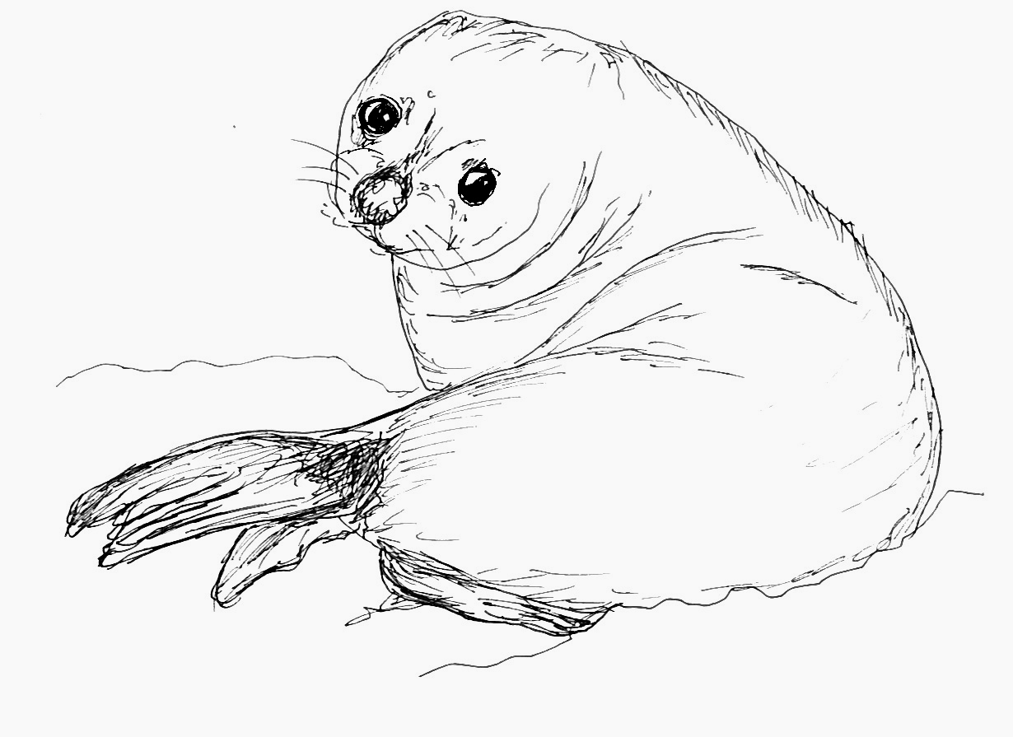
Feeding Seals
Overview
We can give a person 2 buckets if their combined weight is less than or equal to some constant C.
But if we can’t do that, or don’t want to, we can give them just one bucket.
To carry N buckets of various weights, how many people do we need?
99 correct • solved at: 00:07 by
Treevial
University of Cambridge
Author: Ian Pratt-Hartmann

Slide 14
Feeding Seals - Solution
Techniques
Algorithm
Sorting
Two pointers
This is a class of problem called “two pointers”. If we sort all of the weights, we can solve it with a kind of recursive argument:
If anything is going to be paired up, it makes sense to use the smallest item as part of a pair.
We should also use as big an item as possible with the smallest item.
If this can be the largest item, that’s the best option. We throw both the start and end of the array away.
Otherwise, we can never pair the largest item, so we throw it away.
Use two pointers into the ends of the array (or a deque) to implement this efficiently.

Slide 15
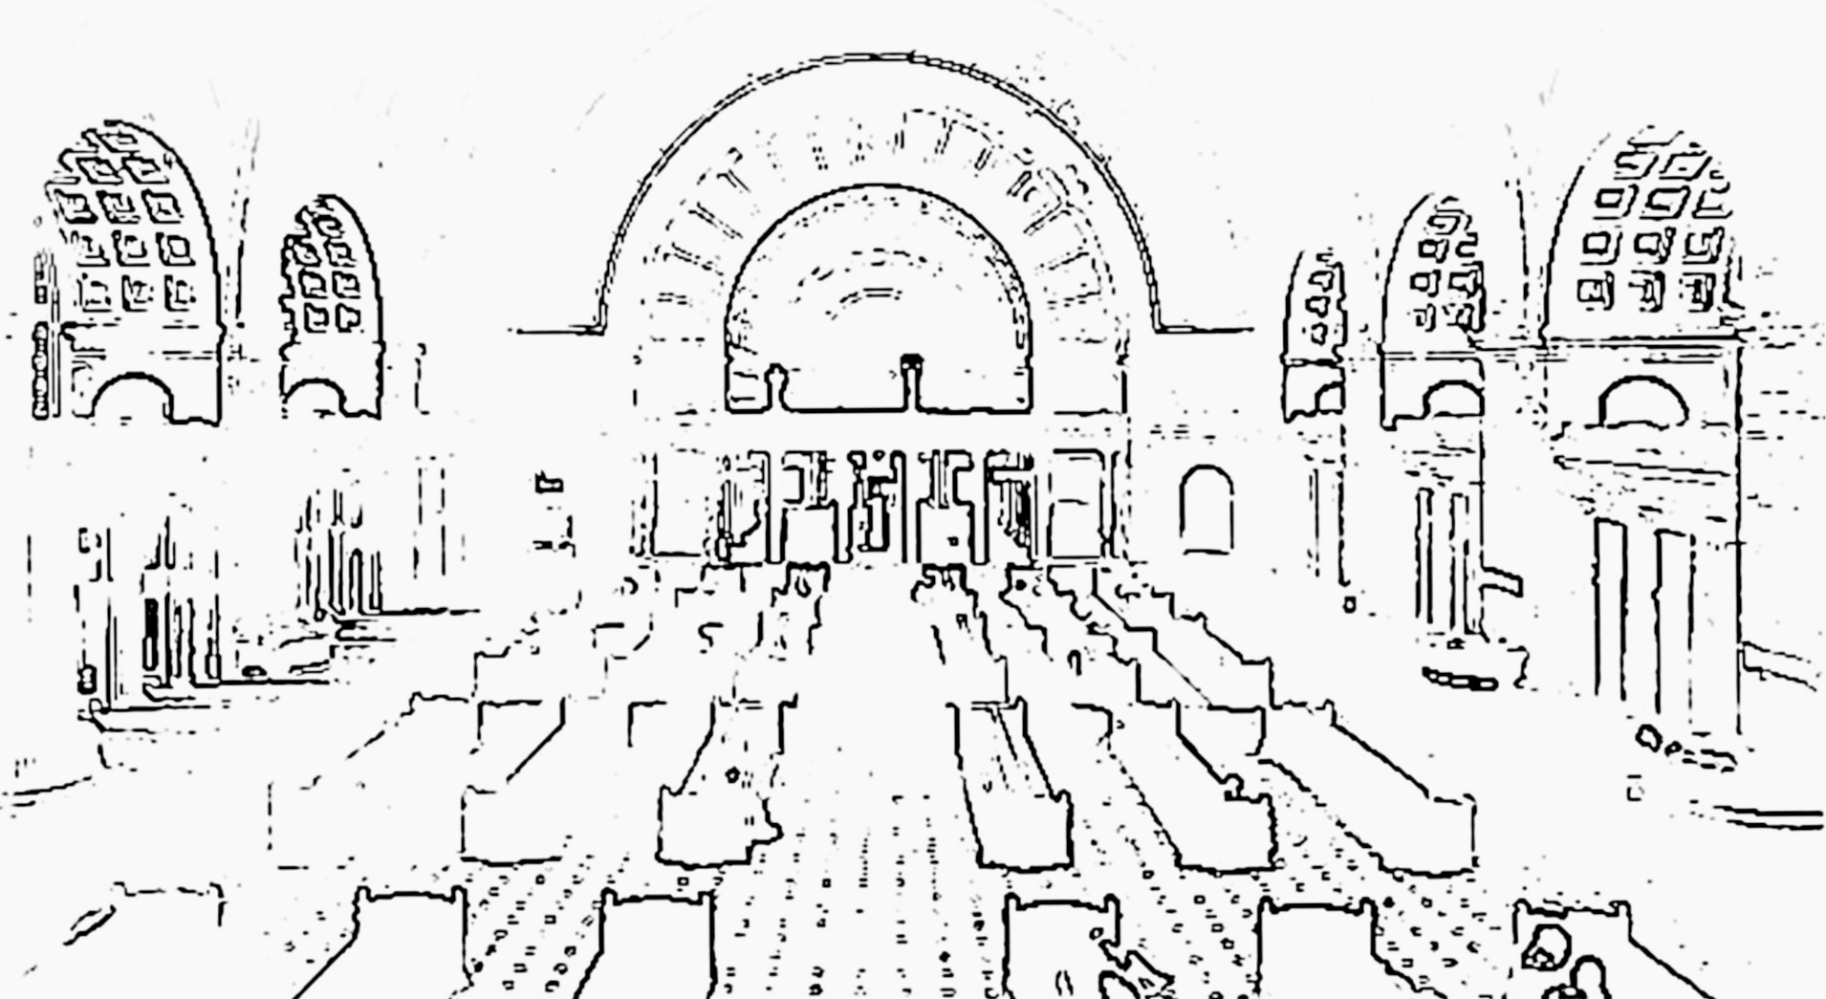
Grand Central Station
Overview
We have an unrooted tree.
We have some anonymous nodes in the tree connected to each other.
How many of the nodes are functionally the same (isomorphic)?
7 correct • solved at: 02:19 by
Treeniceratops
University of Cambridge
Author: Robin Lee

Slide 16
Grand Central Station - Solution
Techniques
Algorithm
Tree centroids
Isomorphism
Hashing
We need a canonical label for each node of the tree.
One way is to make a hash for a node, by taking the hashes of all the other nodes around it and hashing them into one super-hash
Sounds impossible but can be done by excluding one neighbour node at a time.
Another way is to root the tree at its centroid- found by taking the longest path in the tree and looking for the middle node(s) in this path.
Then each node can have a label, and nodes with the same list of child labels can have the same label.
If a node has two child labels, merge them together and count them. Time O(N).

Slide 17
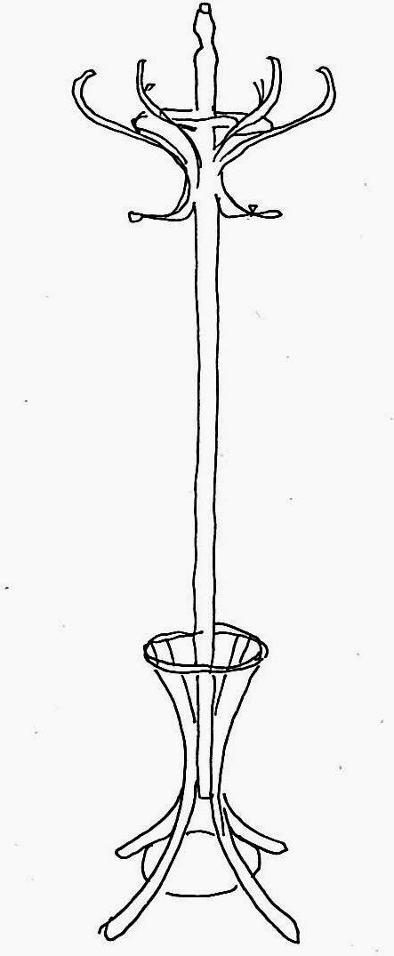
Hat Stand
Overview
We have a unique kind of cache for hats. The last-used item is put in the place of the next-used item.
What is the best way of optimising this cache?
27 correct • solved at: 00:36 by
Treevial
University of Cambridge
Author: Robin Lee

Slide 18
Hat Stand - Solution
Techniques
Algorithm
Simulation
Sorting
Let’s say we already picked an ordering of the hats and simulated it. What would the cost be?
For each starting hook, count the number of accesses and multiply by its index.
For a given hat: the number of accesses for the hook the hat starts on is constant, but we can change the index.
Let’s count the number of accesses in a “default” permutation, and reorder starting from the most accessed items to reduce cost.
Key insight is to forget about the ordering to begin, and only apply it when it starts to matter.

Slide 19
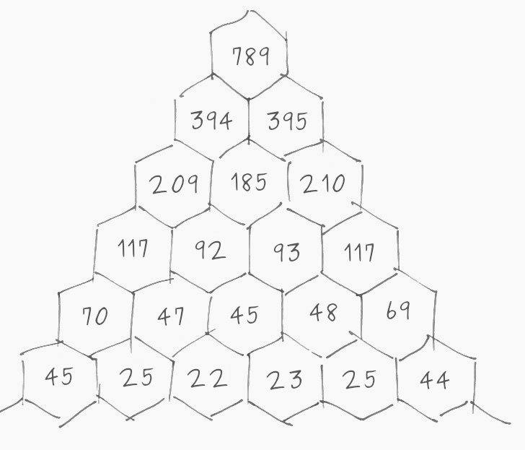
Integral Pyramid
Overview
A pyramid is made by adding numbers on lower rows together.
We want to make a given number at the top. What should the numbers at the bottom be?
78 correct • solved at: 00:10 by
When all else fails take a nap
University of Cambridge
Author: Robin Lee

Slide 20
Integral Pyramid - Solution
Techniques
Algorithm
Dynamic programming
Cheekiness
Start by just putting all 1s in the bottom row.
This gives a sum of 2^(n-1) at the pinnacle.
Now, because there’s only one way for the first and last items to “contribute” to the final score, we can make up the difference in column 0 by adding to it.
As long as we make sure this addition is non-negative. If not, the test case is impossible.
Nicer ways are possible too, but why bother?

Slide 21
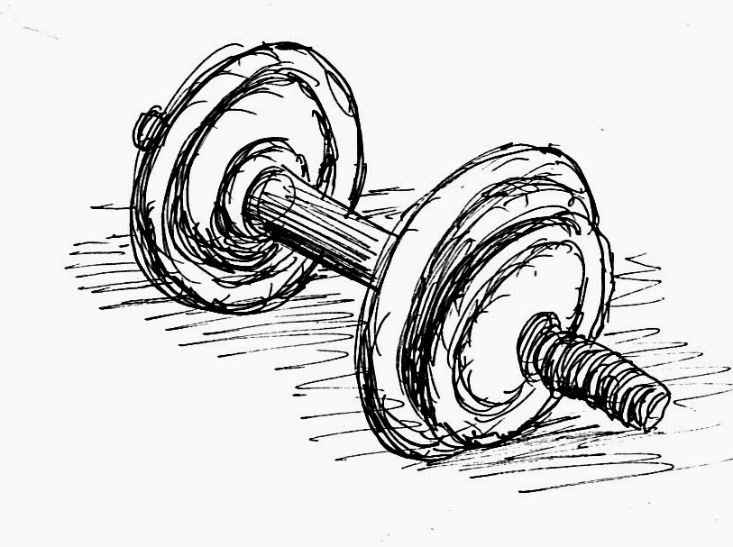
Jammed Gym
Overview
Find a shortest path where each node has multiple locations.
45 correct • solved at: 00:25 by
Kvalitní Slovenskí Programátori
University of Cambridge
Author: Robin Lee

Slide 22
Jammed Gym - Solution
Techniques
Algorithm
Dijkstra’s algorithm
Dynamic programming
Really, nodes of the same kind are not the same, we just need to go to any of them at some time T.
So we can make a table of cost_to_visit[T][NodeId] and only fill it in for the relevant kinds of node at time T.
Iterate through T in increasing order and do an all-pairs comparison to find if:
Station at T is valid to leave from
Station at T+1 is valid to go to.
Read off the minimum number in row T of the matrix at the end.

Slide 23
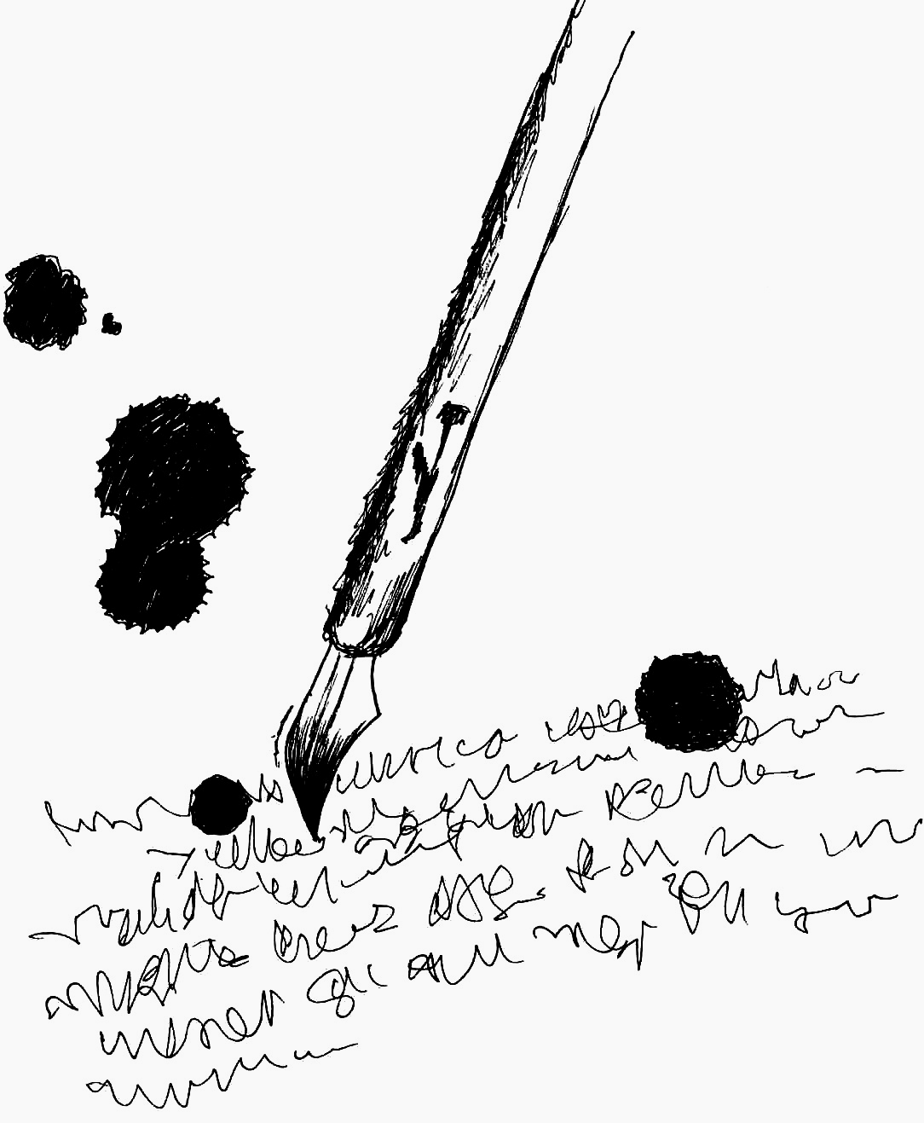
Knocked Ink
Overview
Ink is spreading across a page in circles.
Some ink blots start earlier, others later.
How long until the total area is A?
2 correct • solved at: 04:13 by
Treeniceratops
University of Cambridge
Author: Robin Lee

Slide 24
Knocked Ink - Solution
Techniques
Algorithm
Circle intersection
Line integrals
Green’s theorem
Binary search
Pain tolerance
The spreading out of ink is the easy bit- area covered only increases, so we can run binary search (100+ iterations is plenty).
Now we have to check the area of union of the blots. This is not as easy as it sounds.
Some areas are just covered by one or two blots, other areas can be covered by dozens of blots with circle edges all over the place.
If we can describe the intersecting circles as one continuous polyline, our job is much easier- when we can describe a curve mathematically, we can probably integrate it mathematically too.
Let’s start by figuring out which arcs are on the border
Notes:
This solution is wrong.

Slide 25
Knocked Ink - Solution
Techniques
Algorithm
Circle intersection
Line integrals
Green’s theorem
Binary search
Pain tolerance
Notes:
This solution is wrong.

Slide 26
Knocked Ink - Solution
Techniques
Algorithm
Circle intersection
Line integrals
Green’s theorem
Binary search
Pain tolerance
But… Why not use a spatial data structure?
Let’s take a look.
Notes:
This solution is wrong.

Slide 27
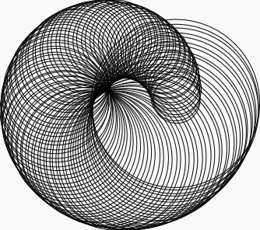
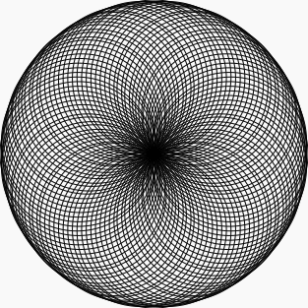

Slide 28
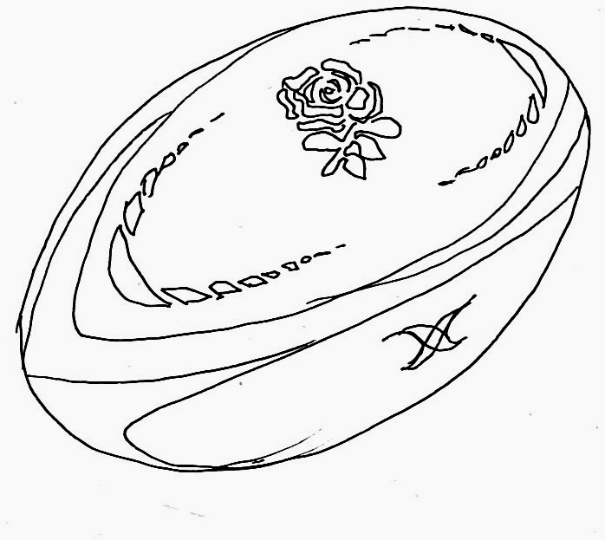
Low Effort League
Overview
How many games do you have to rig/modify to win a tournament?
Specifically, how do you minimise total cost to win if cost to win one game is the square of the difference in skill?
12 correct • solved at: 01:05 by
?‽!
University of Cambridge
Author: Robin Lee

Slide 29
Low Effort League - Solution
Techniques
Algorithm
Dynamic programming
Similar to Jammed Gym- dynamic programming
Cost to have team X in round R = cost[X][R]. This can be calculated by finding all teams T in the adjacent bracket in round R and comparing against cost[T][R-1].
There are X*R cells = R*2^R cells. This is a lot, but not too many to make it slow.
Here, just read off the value of cost[1][R] for the answer.

Slide 30
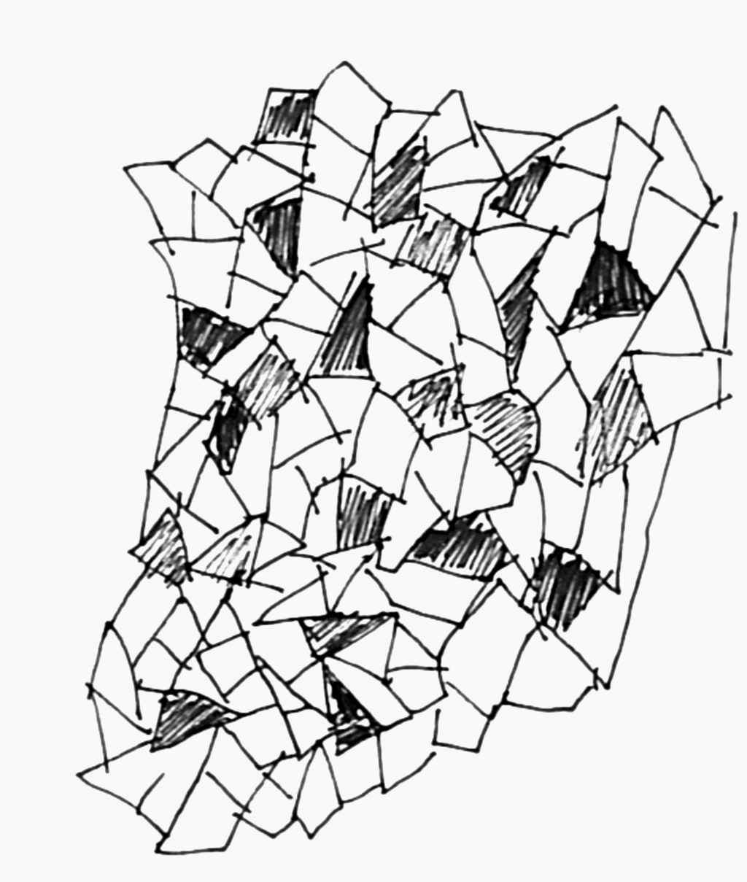
Mosaic
Overview
Remove some rows from a rectangular array to make every value in the array show up equally often.
8 correct • solved at: 01:47 by
Treeniceratops
University of Cambridge
Author: Robin Lee

Slide 31
Mosaic - Solution
Techniques
Algorithm
Meet in the middle
Hashing
Meet in the middle- break 2^40 worth of brute force into 2^20 x 2
Find two “half solutions” which cancel each other out, for example 2xA+1xB in one, and 2xA+3xB in the other.
This is fast enough if the arrays are small,
But the arrays are very large
So make a hash function that still supports adding together and subtracting values in aggregate without recalculating the whole thing
For safety, make several such hash functions in case any one is weak, and bundle them together.

Slide 32
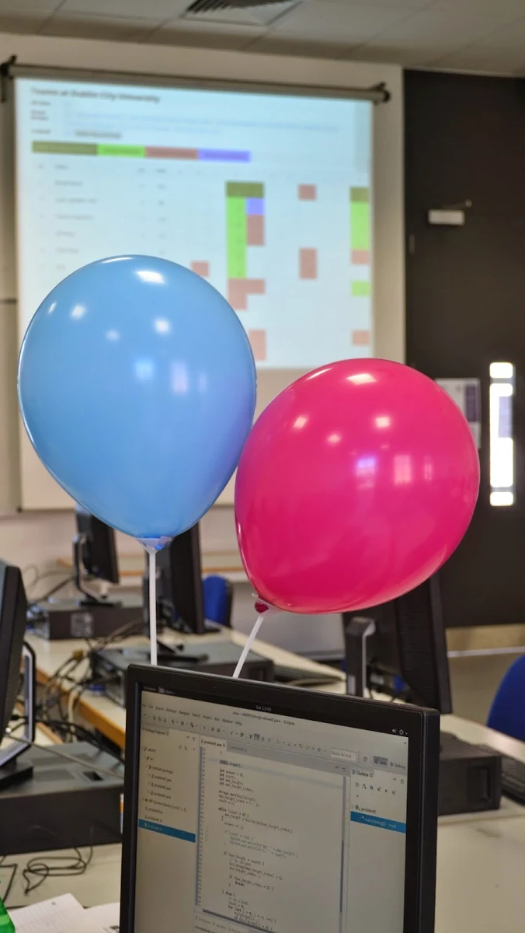
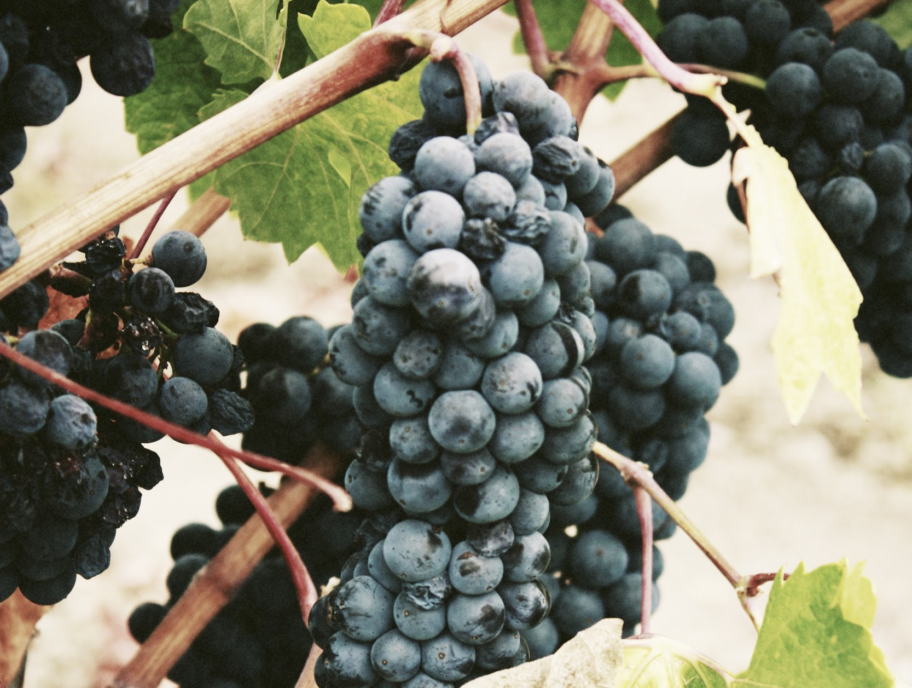

Slide 33
Questions?
Or comments?

Slide 34
Final Standings
http://domjudge.bath.ac.uk/

